Slide 1
ESD 5613 : Final Project (Fall 2021)
Remote Interfacing with 8051
Dhiraj Bennadi
Rajat Chaple
Notes:
Introduction Brief project description :
With current circumstances of COVID like situations, can we eliminate the need of physical access to a hardware. So one can connect to a 8051 based hardware kit remotely and perform operations like programming, memory accesses, gpio reads, etc.
In short, one can do almost all operations remotely which we have covered in labs.

Slide 2

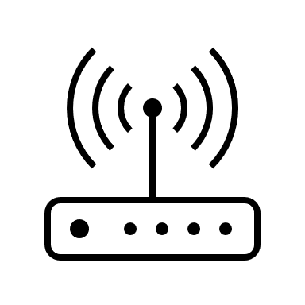

Block Diagram
New
Power Supply
Memory Backup
8051 (uC)
UART
GPIO
New
Target system
LCD Interface
ESP32
MSP432
UART
Notes:
Talk about the host
1. Utility to flash and monitor target system’s memory also monitor gpio
2. User woud have tools to compile build and generate a hex file which is then supposed to be transferred to the target system
3. For the verification of transferred hex file. Hash key wold be generated at the host end.
Target
1. Consists of 8051, Memory –(to store hex file at targets end to verify that transfer is complete (OTA update).
2. ESP8266 would be used to have communication with the host. Data would 2. Whats new (hardware)
-power supply. ESP8266 consumption
-Memory card storage
-Target uController
-ESP8266

Slide 3
Requirement
Designing power supply circuit
Creating PCB schematic and layout
Interface ESP32 with MSP432
Develop a utility to transfer data from Host machine to Embedded device
Entering 8051 into Bootloader using MSP432
Programming the software into 8051

Slide 4
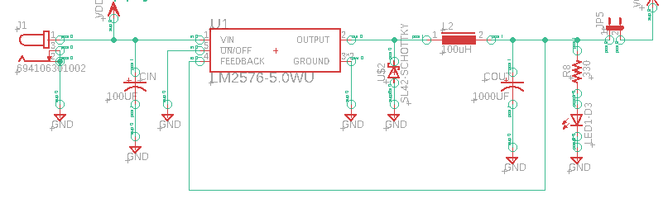
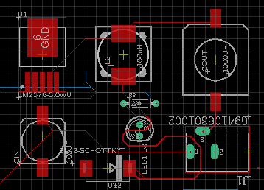
Power supply circuit
Buck switching regulator
Vout : 5V
Iout : 3A (max value)

Slide 5
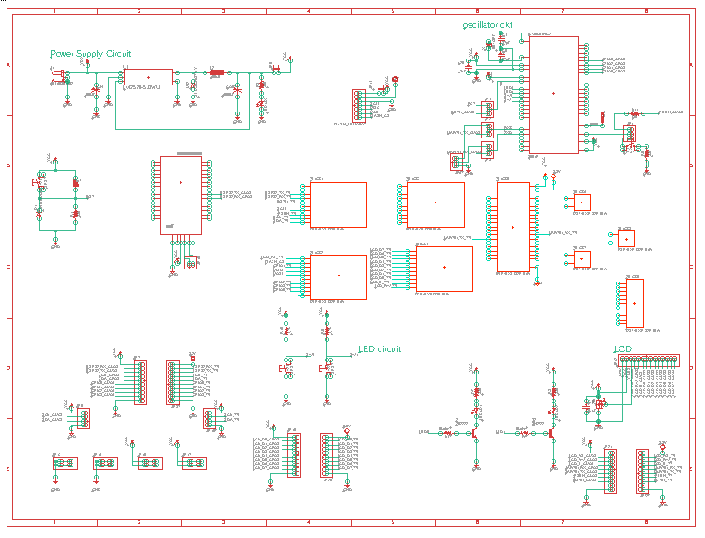
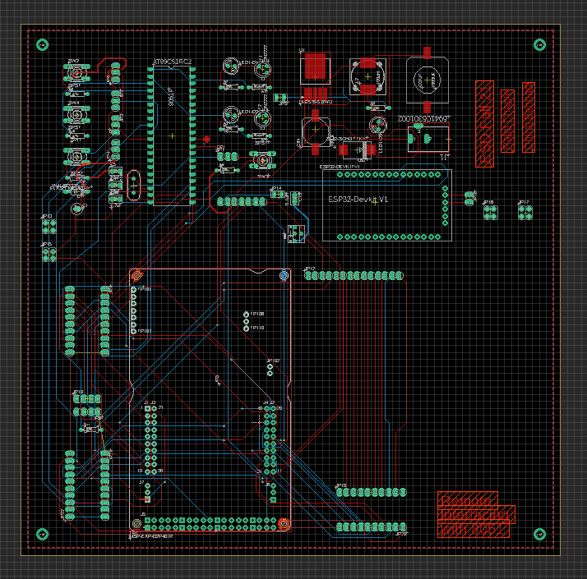
PCB Design and Layout
Software used : Autodesk Eagle

Slide 6
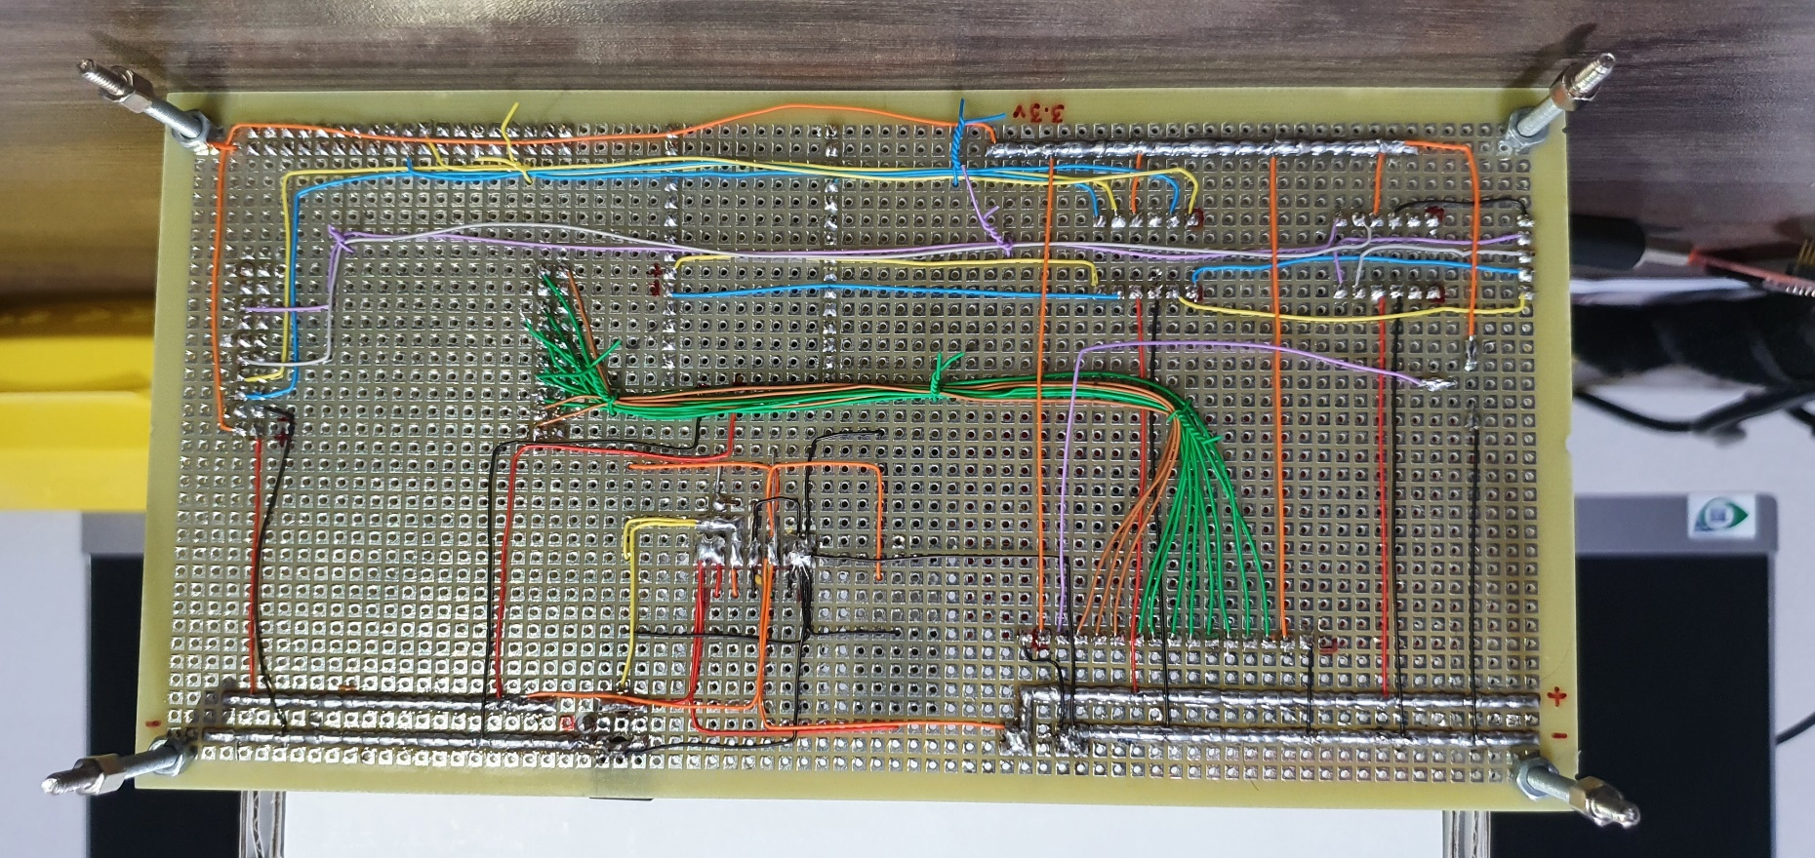
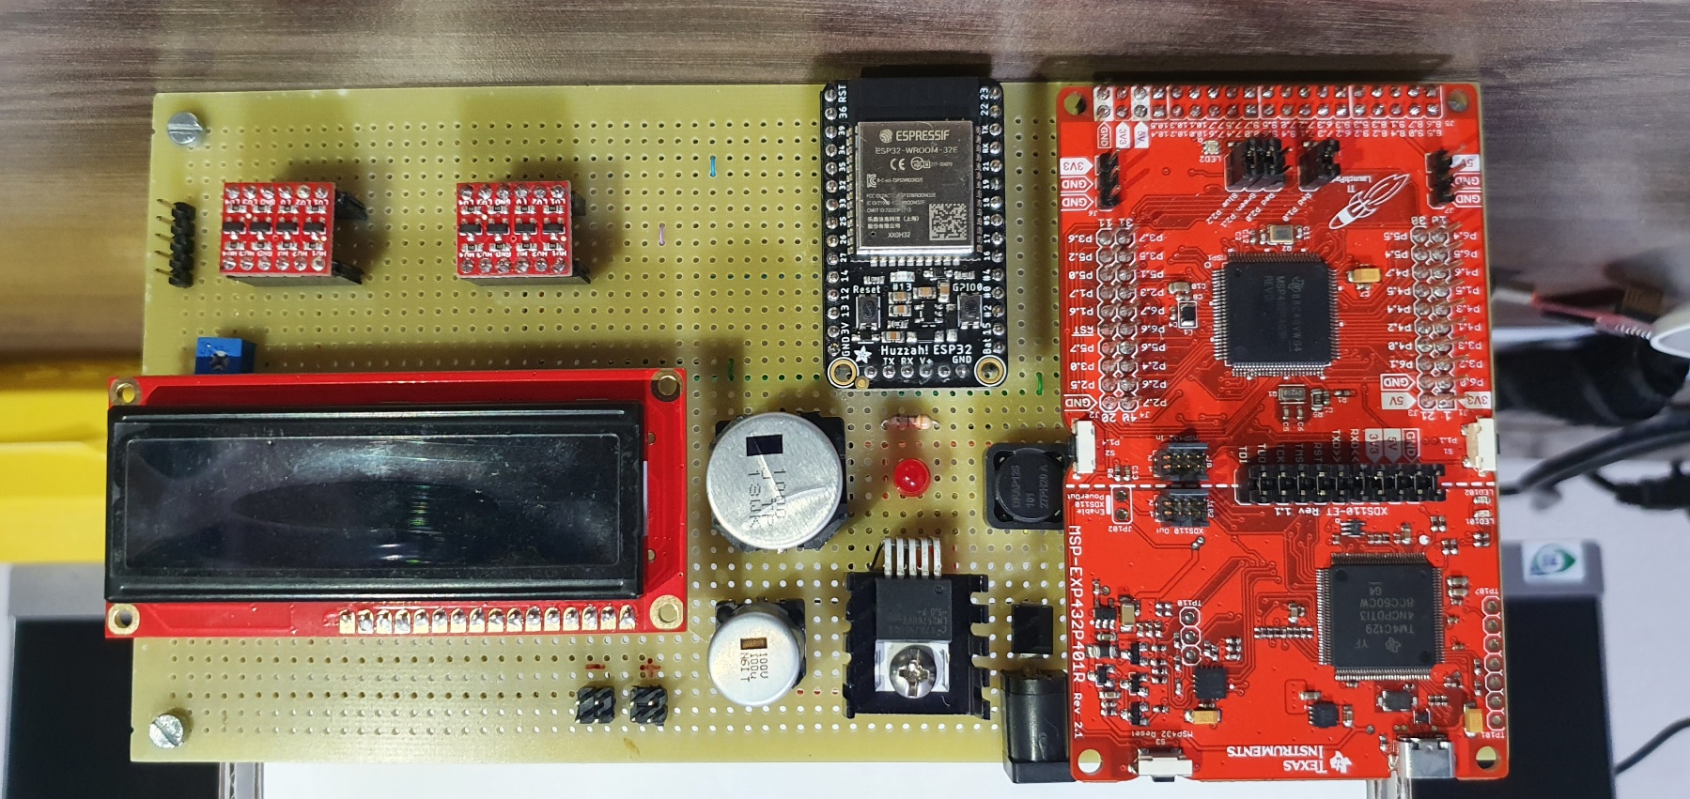
PCB Design and Layout

Slide 7


Slide 8
ESP32 interfacing with MSP432
Set up WIFI mode
ESP32 firmware: ESP32-WROOM-32_AT_Bin_V2.2.0.0
Set up ssid, password
Connect to WIFI
ESP32
MSP432
UART
Logic Level Shifter
UART2
Set up multiconnection mode
Set up sever

Slide 9
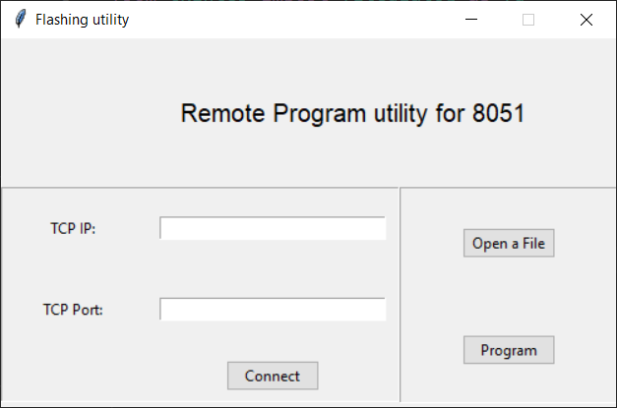
Flashing utility
Enter TCIP IP and Port
Click connect
Select HEX file using open file buton
Click program to send file over TCP IP

Slide 10
Challenges
Timeline shifted due to dependency on vendors
Combination of SMD components and through hole components for zero PCB soldering
Memory card interfacing

Slide 11
Thank you…

